Slide 1
NELIREF DATA SCIENCE/AI SYMPOSIUM

Slide 2
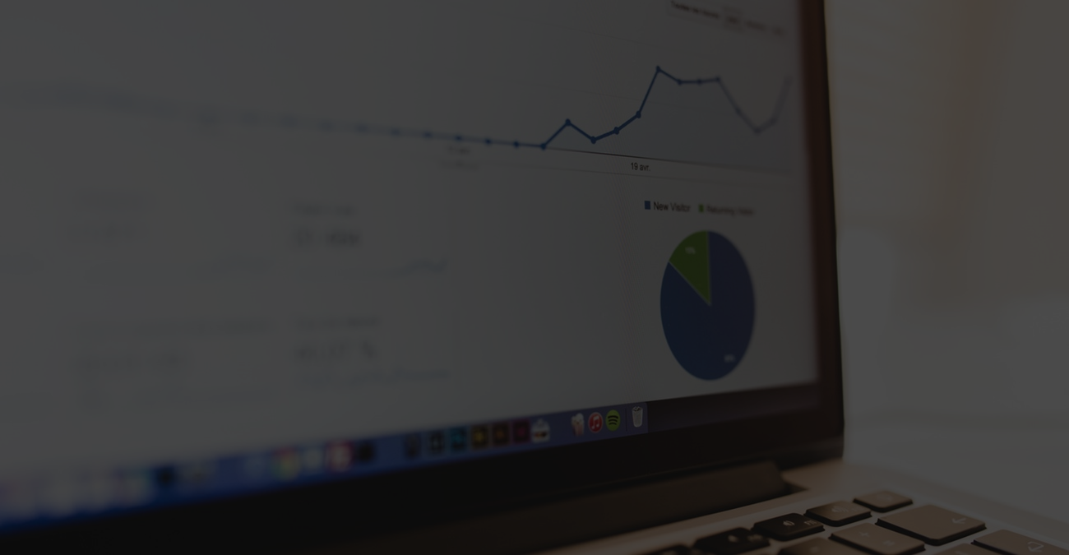
Introduction to Machine Learning & Artificial Intelligence with Python

Slide 3
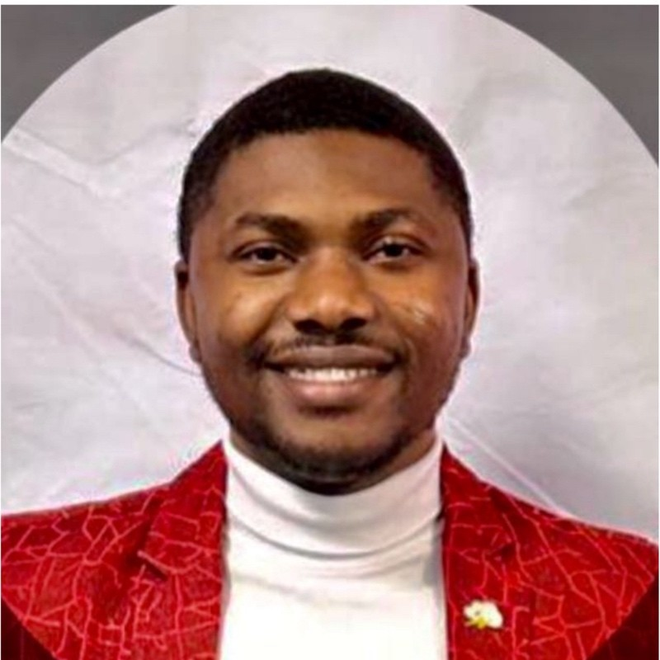
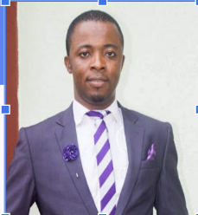
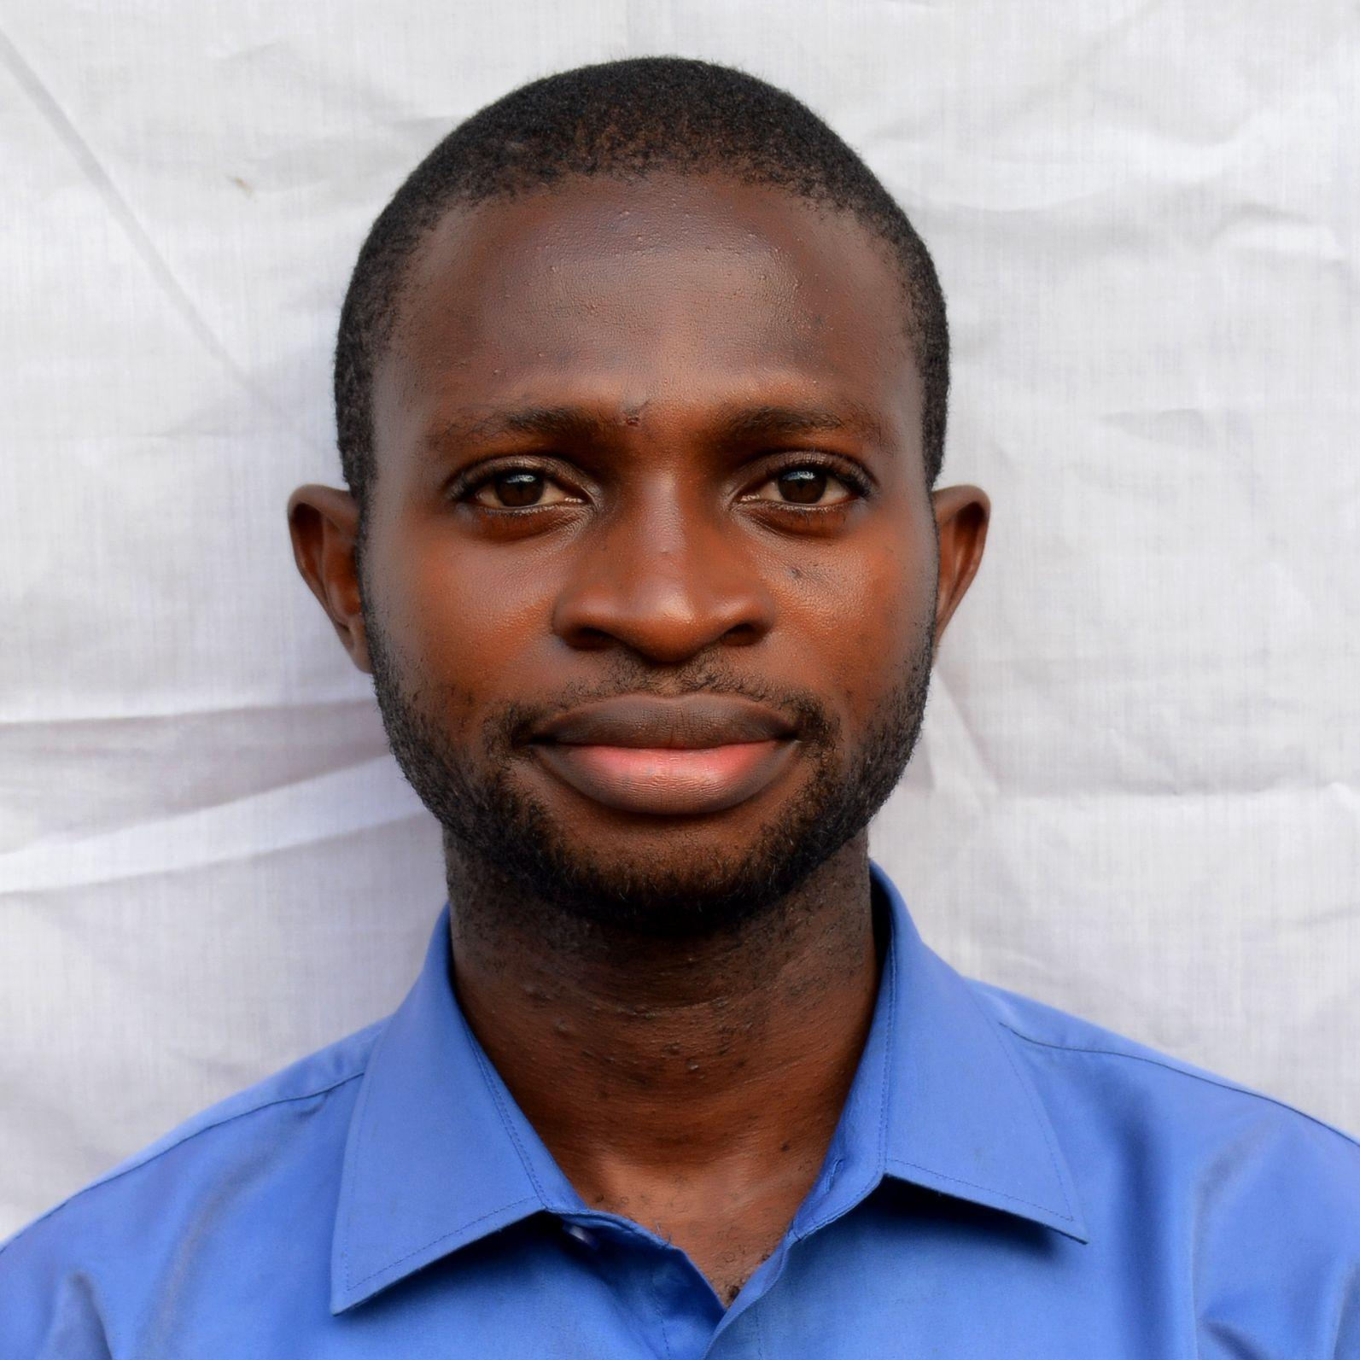
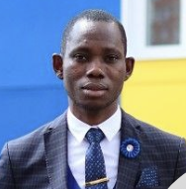
INSTRUCTORS
Roland Abi
Abraham Idu
Joseph Tachia
Gabriel Terkuma Saaondo
Msc Data Science (Washington DC)
Quality Data Scientist Intern
(Intuitive Surgicals)
Msc Applied Bioinformatics (in-view) MIPT, Moscow
M.Sc Plasma Physics Moscow Institute of Physics and Technology
BSc Botany
University of Agriculture Makurdi

Slide 4
AGENDA
INTRODUCTION
ML Ecosystem
Q & A
ML Concepts
HANDS- ON
What is Artificial Intelligence/Machine Learning
General purpose AI/ML and their applications
Questions and Answers
Common concepts used in AI/ML
Hands-on session

Slide 5
Introduction: What is AI/ML

Slide 6
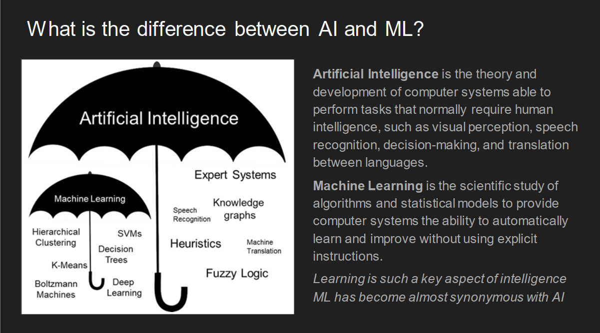

Slide 7
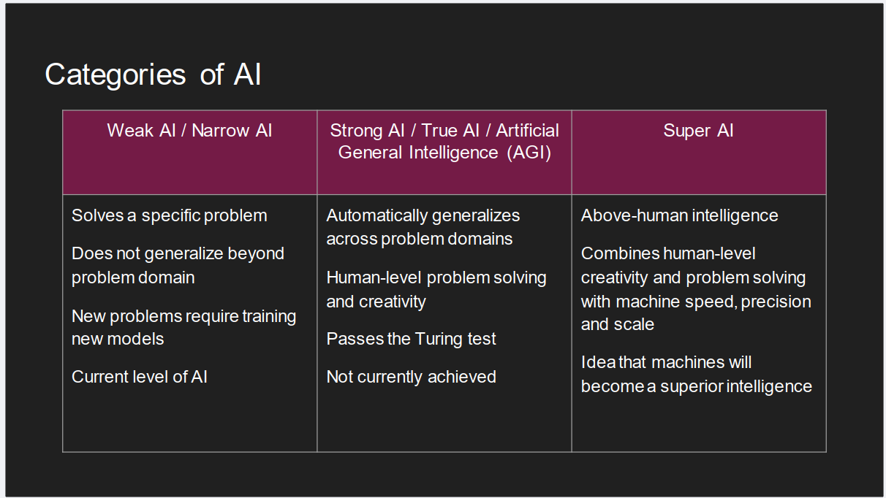

Slide 8
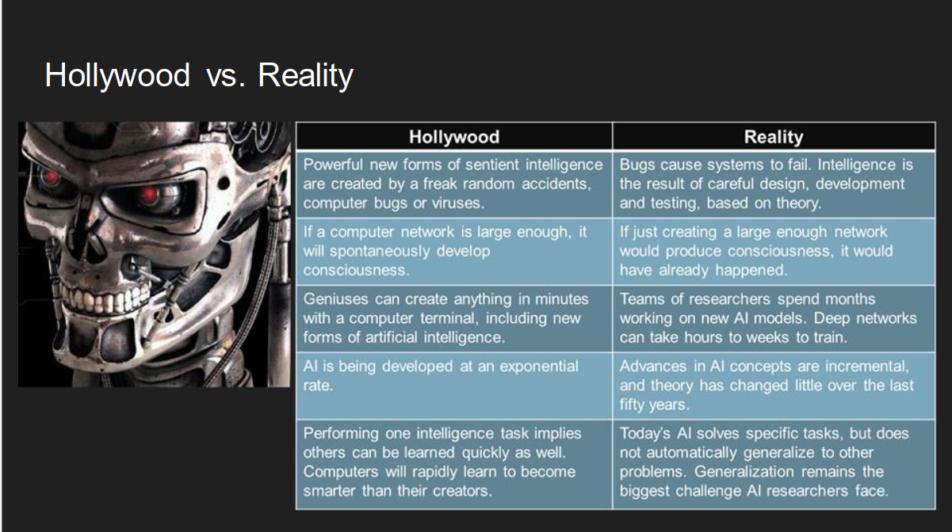

Slide 9
ML Concepts

Slide 10
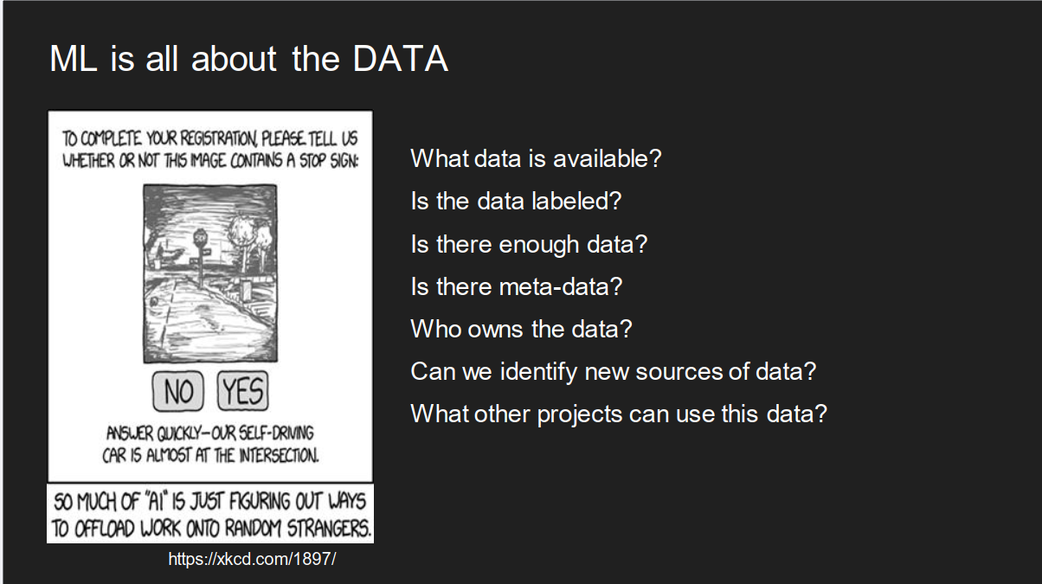

Slide 11
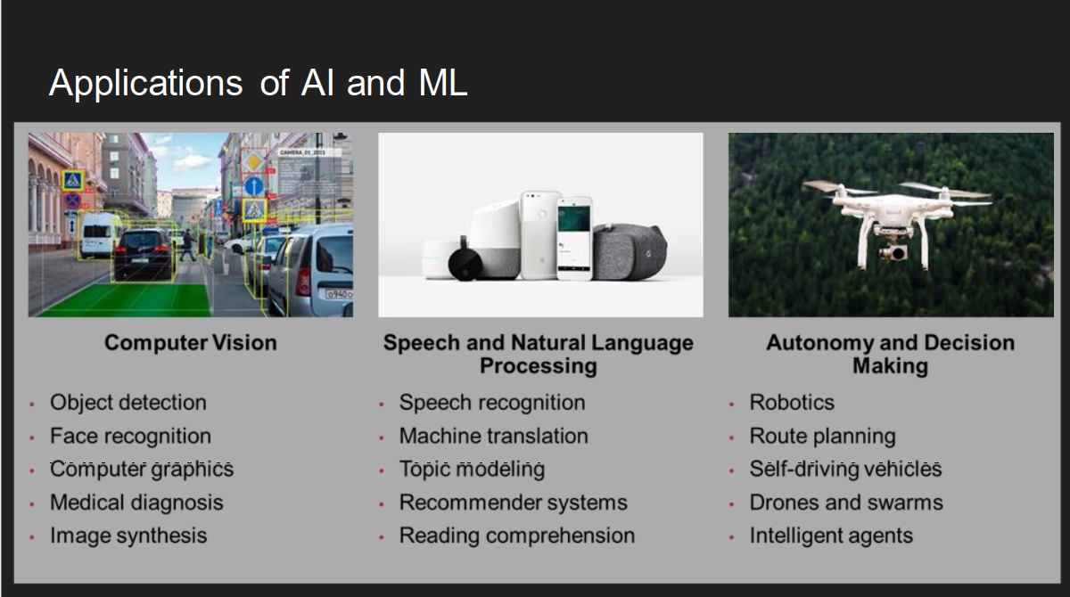

Slide 12
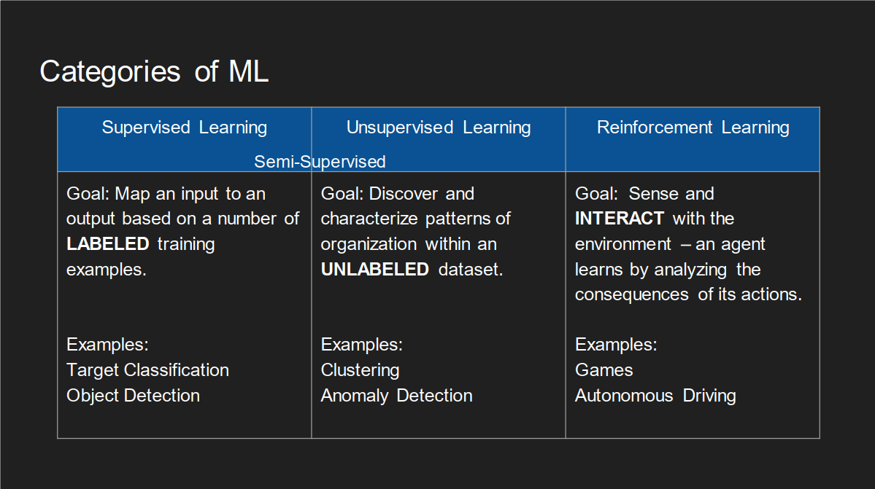

Slide 13
ML Ecosystem

Slide 14
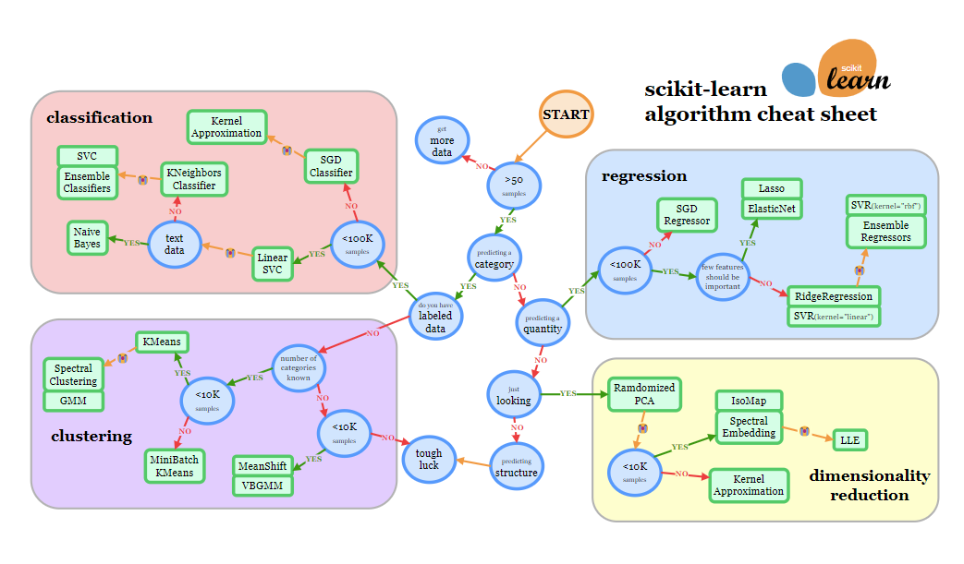
Machine learning is not one size fits all

Slide 15
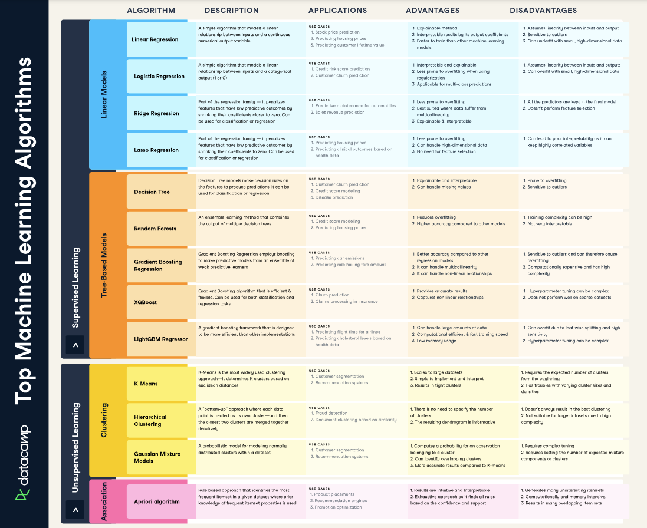
https://www.datacamp.com/cheat-sheet/machine-learning-cheat-sheet

Slide 16
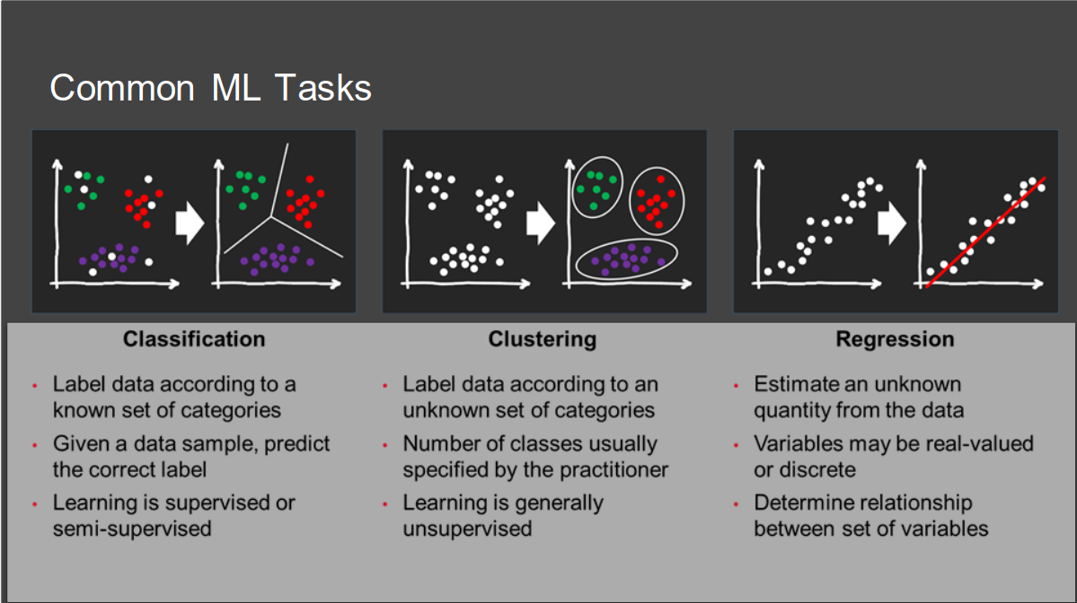

Slide 17
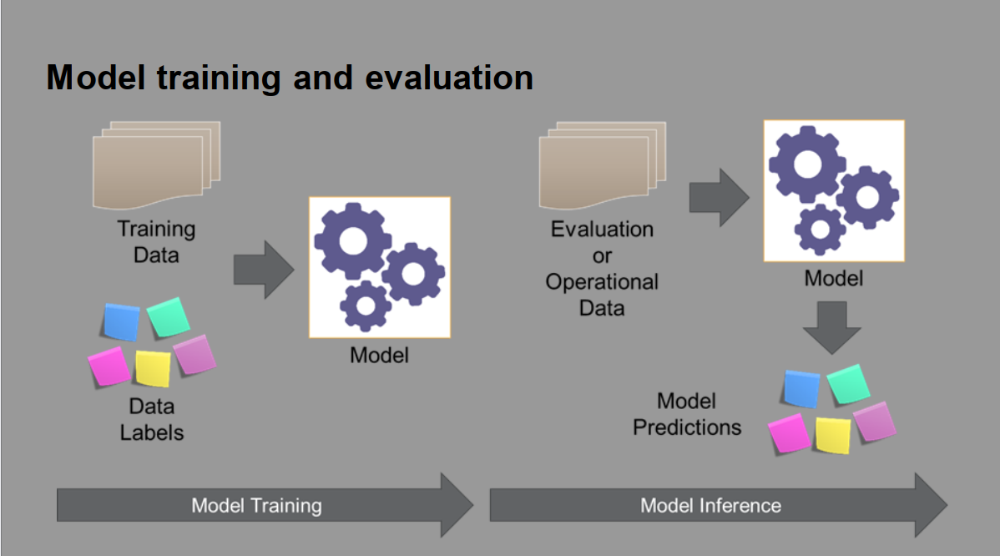

Slide 18
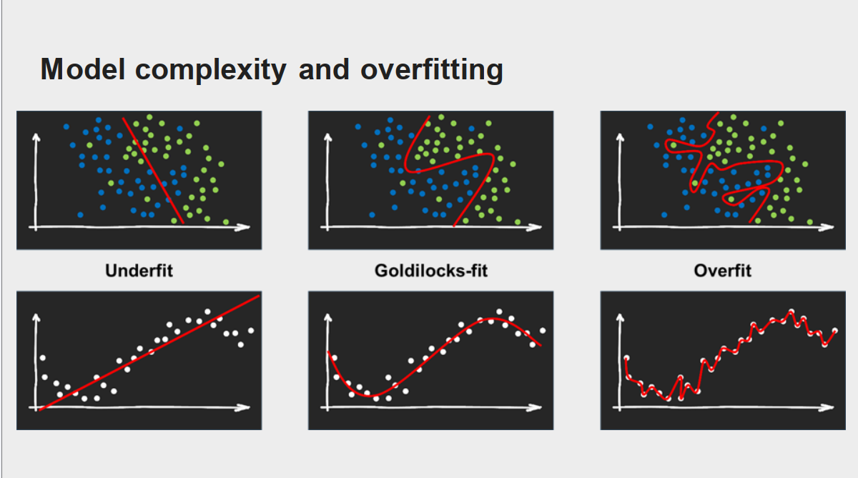

Slide 19
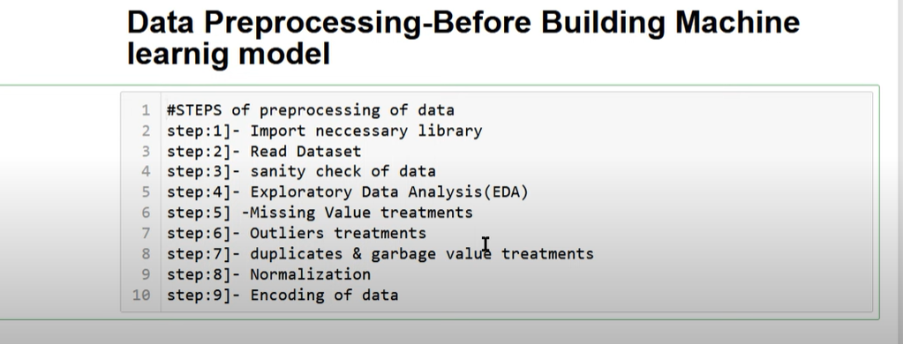

Slide 20
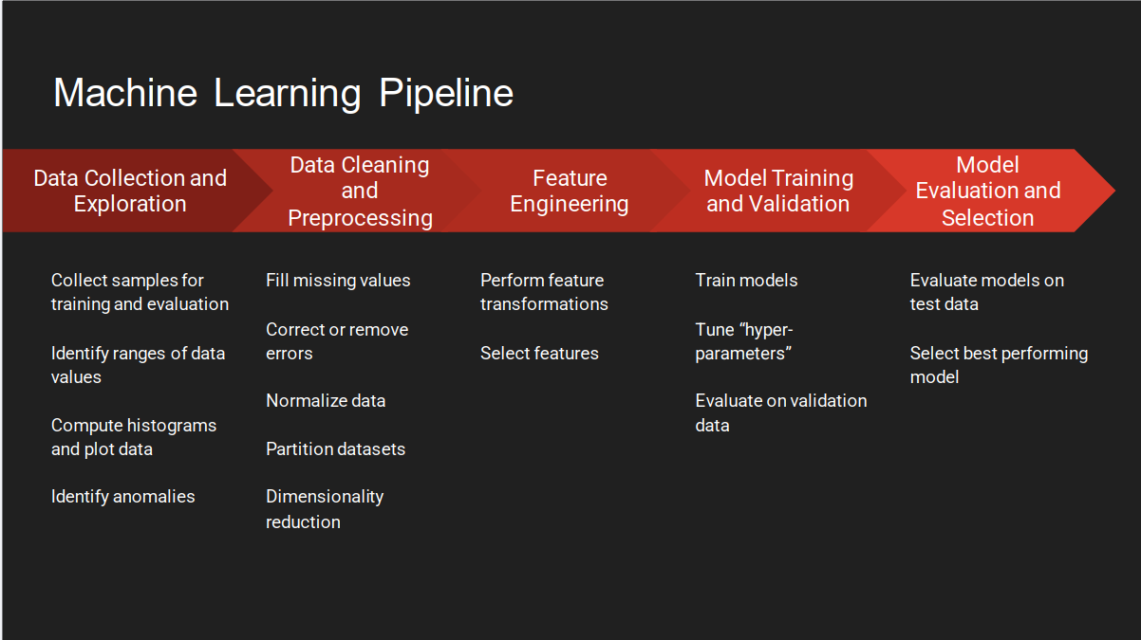

Slide 21

HANDS-ON EXPERIENCE

Slide 22

Q & A

